Slide 1
Multilingual Query–Category Relevance in E-Commerce Search
TEAM: 101 Not Found
Aditya Pranjal
Saumil Yadav
Aditya Aggarwal
Arnav Pundir

Slide 2
Problem
The Challenge: Connecting millions of user search queries to the right product categories across multiple languages and complex product hierarchies.
🌍 Multilingual queries: Multiple languages requires a solution that can handle linguistic variations and nuances.
📂 Complex product hierarchies: Product categories are structured in deep, branching hierarchies making precise mapping difficult.
⚠️ Misclassification reduces relevance: A simple keyword match is not enough, leading to poor user experience, irrelevant search results, and missed conversions.
User Query:
(e.g., 'red running shoes')
Category Path:
(Sportswear > Footwear > Running Shoes)

Slide 3
Insight
Query–Category Relevance Task: A machine learning system designed to map user search queries to the most relevant product categories in a large scale, multilingual e-commerce system.
→ User Query can be short, ambiguous, may use slang, brand names, or local abbreviations unfamiliar to a search algorithm. It requires a enormous database to fetch data from and a complex mapping.
Impact of Accurate Mapping:
✅ Faster relevant results
🧠 Better understanding of intent
🎯 Improved personalization
📈 Higher conversions

Slide 4
Solution
OUR MODEL:
We add language as a input variable before the rest to manage multilingual queries. Another solution is to build individual models per language.
To convert the input queries and hierarchies into a format that the AI model understands, we used TF-IDF (Term freq-Inverse Doc-freq) vectorization which gives importance to unique terms such as “shoes” instead of “red” and converts them to a numeric value.
Language
Vectorised Input
Model
Query
Output
0/1
Hierarchy

Slide 5
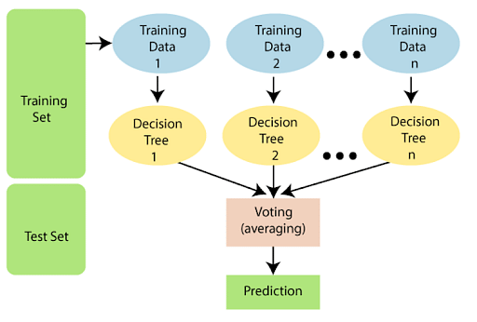
Solution
Using bigrams on top of unigrams allows check 2 tokens together such as “running shoes” together instead of just separately.
We use Random Forest method of machine learning as it is suitable for yes/no decision making. Grid Search is used to optimise hyperparameters.
We have used scikit-learn in python to implement this solution.

Slide 6
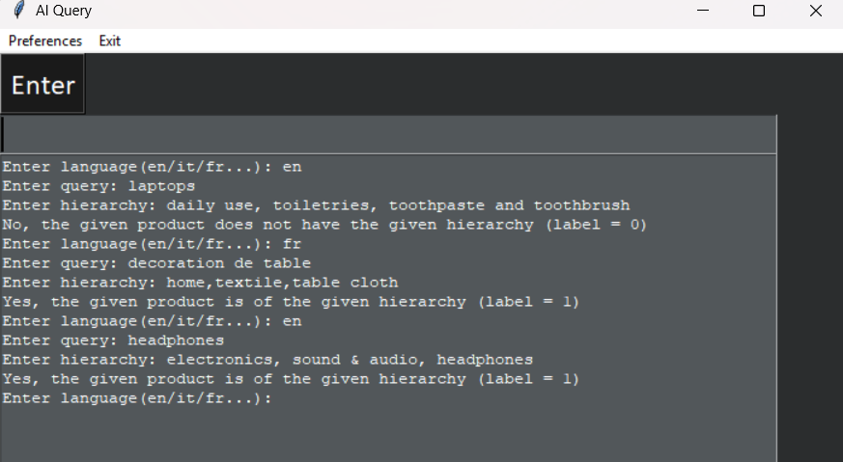
Demo

Slide 7
Next Steps
There are some pitfalls in this solution leading to inaccuracies.
Examples are: Not vast enough training set, biased training set, missing edge cases.
A solution to fix this in production is to assume that our classification is wrong, and retrieve the product hierarchy of the products that interest the user most and create that as a new query, hierarchy pair. This way, the model can correct itself or reinforce correct results.
📌 Dataset preparation
⚙️ Train baseline models
🔬 Fine-tune
🚀 Deploy API
📊 Monitor & iterate

Slide 8
THANK YOU

